Slide 1
Hannah 哈拿
Hannah and Anna: Two Good and Godly Women
哈拿和亚拿：两个善良敬虔的女人
Dr. Victor Hamilton

Slide 2
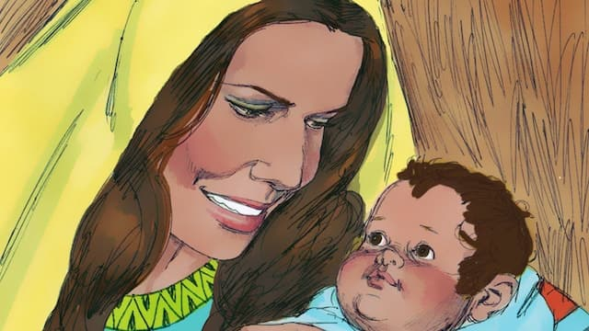
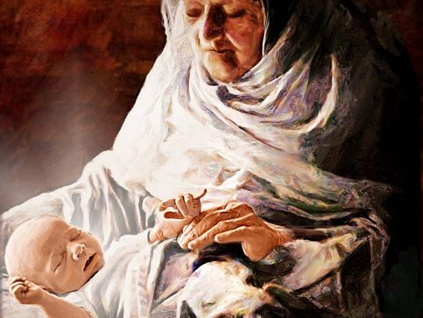
Two Good and Godly Women
Hannah and Anna
两个善良敬虔的女人 哈拿和亚拿

Slide 3
What possibly could a young Mother from early in the OT have in common with an elderly widow mentioned briefly in the NT who just happened to get in on the birth of Jesus?
一位旧约早期的年轻母亲与一位在新约中被简要提及的老寡妇有什么共同点（老寡妇刚好知道耶稣的诞生）？

Slide 4
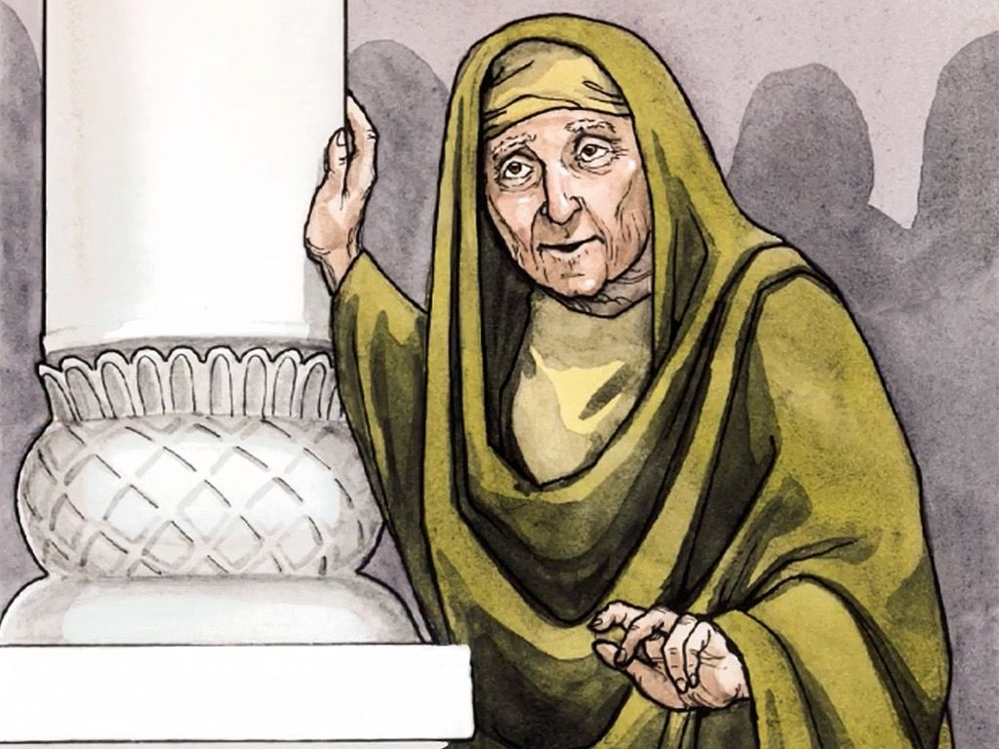
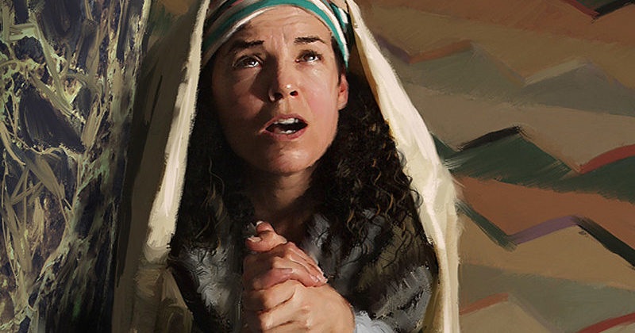
Both women share the same name
两个女人同名
Anna
Hannah
grace / favor 恩典/偏爱

Slide 5
“palindrome” 左右字母对称
Anna 亚拿
Hannah 哈拿

Slide 6
Both of these ladies are northerners
两位女士都是北方人
Northern tribe of Asher
Ephraim
以法莲
亚设北部支派
1 Samuel 撒上 1:1
Luke 路 2:36

Slide 7
Both of these ladies are important in the Bible principally because they are associated with the birth of a very important child.
两位女士在圣经中都很重要，主要是因为她们与一个非常重要的孩子的出生有关。

Slide 8
Hannah gave birth to Samuel who later in life would go on to become one of the greatest prophets in the OT.
哈拿生下了撒母耳,旧约中最伟大的先知之一
耶和华立撒母耳为先知
1 Sa 撒上 3:20

Slide 9
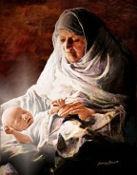
There was a prophet, Anna…
又有女先知名叫亚拿…
Luke 路 2:36

Slide 10
Both Hannah and Anna went through much difficult and long suffering, and in both instances the pain and suffering were related to marriage.
哈拿和亚拿都经历了很多艰难和长期的痛苦，而这两种痛苦都与婚姻有关。

Slide 11
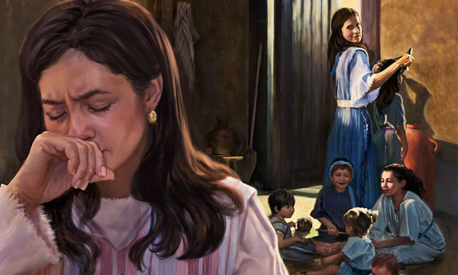
Hannah 哈拿
The Lord had closed her womb.
耶和华不使哈拿生育
1Sa 撒上1:6

Slide 12
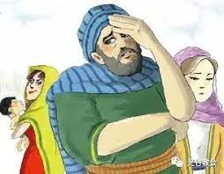
Hannah 哈拿
She was just one of two women who were married to the same husband at the same time
她是同时嫁给同一个丈夫的两个女人之一

Slide 13
Anna 亚拿
She was married to her husband around the age of 12 to 14 for seven years. Her husband died after those 7 short years
她还是12-14岁的童女时就出嫁，同丈夫住了七年就寡居了

Slide 14
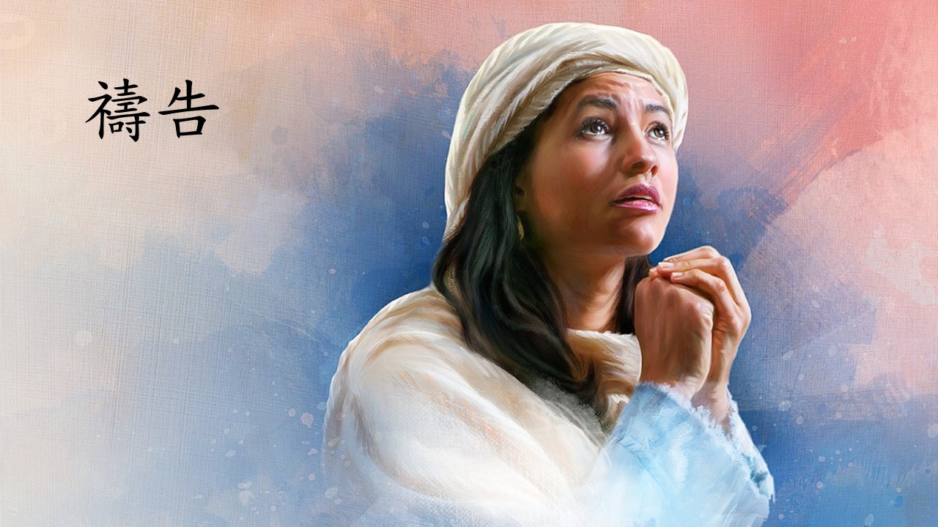
Both of these women were in the house of God, the Temple, praying, and both prayed silently
这两个女人都在神的殿堂里，在圣殿里祈祷，而且都默默地祈祷

Slide 15
Hannah was praying in her heart, and her lips were moving, but her voice was not heard. Eli thought she was drunk
哈拿心中默祷，只动嘴唇，不出声音，因此以利以为她喝醉了。
1Sa 撒上1:13

Slide 16
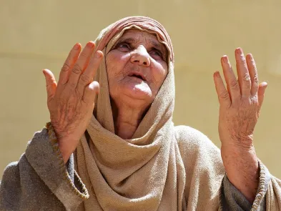
as a widow until she was eighty-four.
She did not depart from the temple, worshiping with fasting and prayer night and day.
现在已经八十四岁，并不离开圣殿，禁食、祈求，昼夜侍奉神。。
Luke 路2:37

Slide 17
Hannah made a vow
哈拿许愿
… give to your servant a son, then I will give him to the LORD all the days of his life
…赐我一个儿子，我必使他终身归于耶和华
1Sa 撒上1:11

Slide 18
When you vow a vow to God, do not delay paying it, for he has no pleasure in fools. Pay what you vow. It is better that you should not vow than that you should vow and not pay.
你向神许愿，偿还不可迟延，因他不喜悦愚昧人。所以你许的愿应当偿还，你许愿不还，不如不许。
Ecclesiastes 传道书 5:4-5

Slide 19
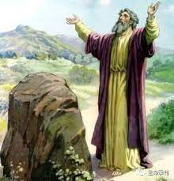
Instances of somebody making a vow to the Lord in the OT
旧约中向主发誓的例子
Then Jacob made a vow saying…
雅各许愿说…
Genesis 创世记 28:20

Slide 20
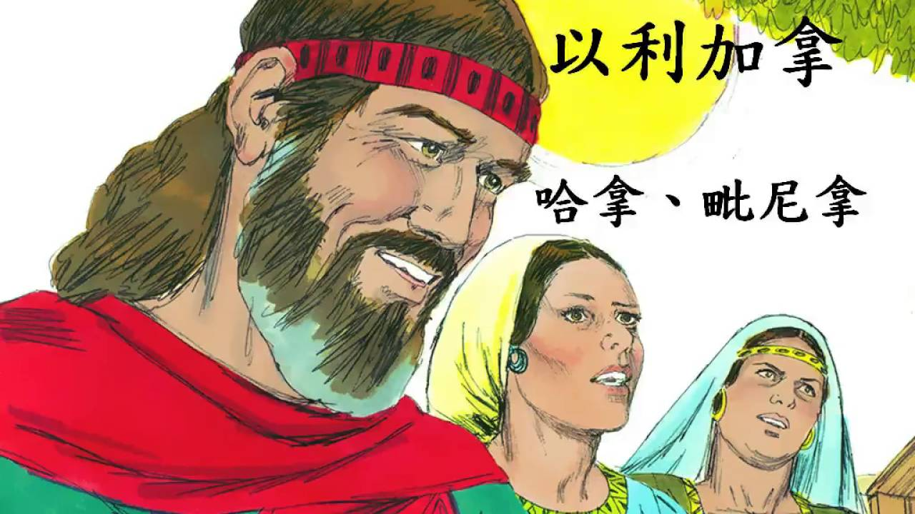
Hannah and Peninnah
哈拿和毗尼拿
Children - Love

Slide 21
Anna 亚拿
She has lived by herself alone for 60 or 80 years
她独自生活了60或80年
Here he is Anna,
the Messiah
安娜，弥赛亚在这里

Slide 22
all Mothers 妈妈们

